Slide 1

PRESENTATION TITLE
1.14.2012
Notes:
Adjust the size to spread across the line and logo
Arial, BOLD
Keep it a simple one liner
All Caps

Slide 2


PAGE TITLE
Notes:
Image page, no text necessary;
Simply replace the Page Title text but keep it this size, caps and bold;
Text is always Arial;
When placing the Propriety text and Logo, duplicate it on each slide so it stays in the same spot

Slide 3
PAGE TITLE
Pimus crist intilib ulinteberem ad corarbement
Pimus auctuit L. Opiondaccis inpristam avo, volus es, cori iaeque nos conem us, facit.
Pimus auctuit L. Opiondaccis inpristam avo, volus es, cori iaeque nos conem us, facit.
IMAGE TITLE (IF NEEDED)
Notes:
Text is always Arial
Keep the info text minimal if it’s necessary to have
Subtitle is Arial size 14 bold
Example of a sentence and a bullet point in Arial size 12 regular
If image requires a title keep it CAPS and below image

Slide 4
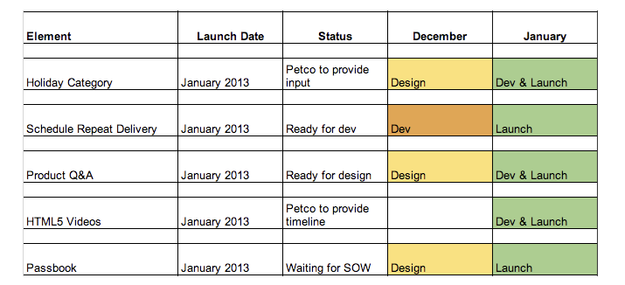
PAGE TITLE
Image description (if needed)
Notes:
Text is always Arial
Image should be centered if it takes up the page
If it requires a short description keep it in Sentence case.

Slide 5
PAGE TITLE
Pimus crist intilib ulinteberem ad corarbement. auctuit L. Opiondaccis inpristam avo, volus esus, facit.
Pimus crist intilib ulinteberem ad corarbement. auctuit L. Opiondaccis inpristam avo, volus esus, facit.
Pimus crist intilib ulinteberem ad corarbement. Opiondaccis inpristam avo, volus esus, facit.
Pimus crist intilib ulinteberem ad corarbement. auctuit L. Opiondaccis inpristam avo, volus esus, facit.
Pimus crist intilib ulinteberem ad corarbement. auctuit L. Opiondaccis inpristam avo, volus esus, facit.
Pimus crist intilib ulinteberem ad corarbement. Opiondaccis inpristam avo, volus esus, facit.
Notes:
If there is a text page, keep it short and sweet
Text is always Arial, size 14 for all text

